Slide 1


Slide 2
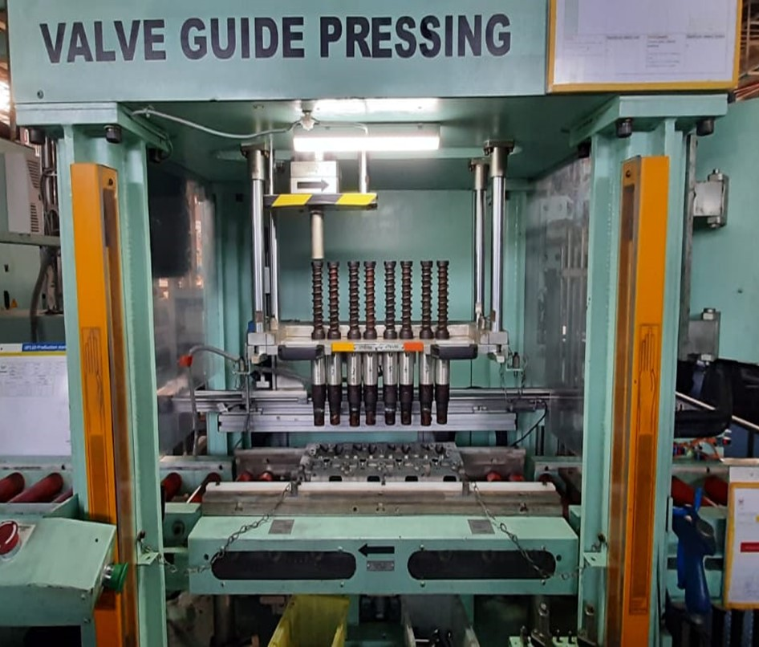
POKE YOKE
Valve guide press Right condition :
Exhaust valve guide pin
Intake valve guide pin
A B A B A B A B

Slide 4
Different model for Pitch Details
3TNV88
3TNV82
3TNV80F
42mm
41.6mm
40mm
4TNV88
4TNV98
42mm
47mm

Slide 5
Machine front view:
300mm
155mm
35mm
65mm
75mm
HEAD
300mm

Slide 6
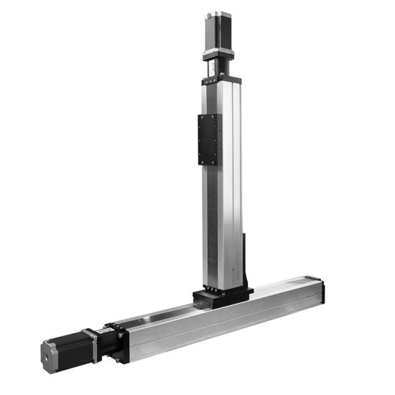
Intake & Exhaust valve guide checking conditions :
Liner Mechanism by using stepper motor control:
Z- Axis
X- Axis
Check Position 1
Check Position 2
We can verify the each pin height in two position OK or NG

Slide 7

Intake & Exhaust valve guide pressing conditions :
0
ACTUAL CONDITION
A A A B A B A B
A B A B A B A B
0
0
Intake & exhaust bush error condition -2
Intake bush error condition -3
B A A B A B A B
B B A B A B A B

Slide 8
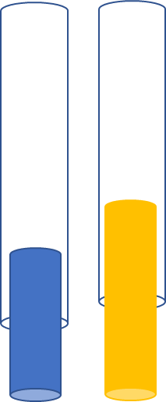
Valve guide OK condition:
Exhaust valve guide pin
Intake valve guide pin
OK
Z- Axis
A
B
1St position not sense -OK
1St position not sense -OK
2St position it should be sense -OK
X- Axis

Slide 9
Intake & Exhaust valve guide pressing conditions :
0
Exhaust bush error conditon-1
A A A B A B A B
0
0
Intake & exhaust bush error condition -2
Intake bush error condition -3
B A A B A B A B
B B A B A B A B

Slide 10
Valve guide Exhaust pin NG condition:
Exhaust valve guide pin
Intake valve guide pin
NG
Z- Axis
1St position not sense -OK
1St position not sense -OK
2St position if not sense- NG
X- Axis

Slide 11
Intake & Exhaust valve guide pressing conditions :
0
Intake & exhaust bush error condition -2
B A A B A B A B
0
Intake bush error condition -3
B B A B A B A B

Slide 12
Valve guide Exhaust pin NG condition:
Exhaust valve guide pin
Intake valve guide pin
NG
B
Z- Axis
B
1St position if sense -NG
X- Axis

Slide 13
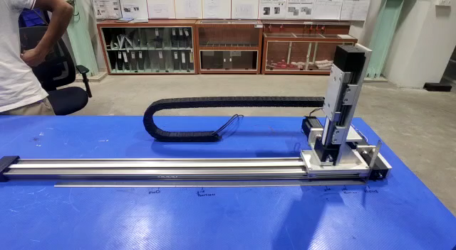
Linear guide assembled & taken trial in outside:

Slide 14
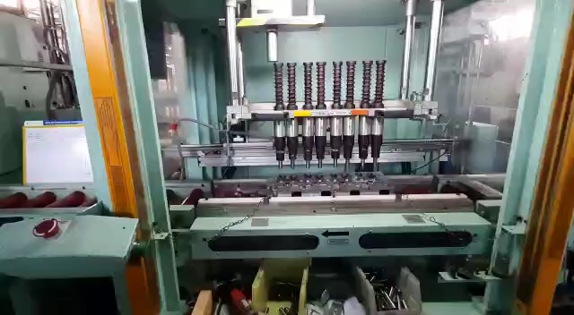
Linear guide assembled in machine & checked the auto mode for Valve guide pin :

Slide 15
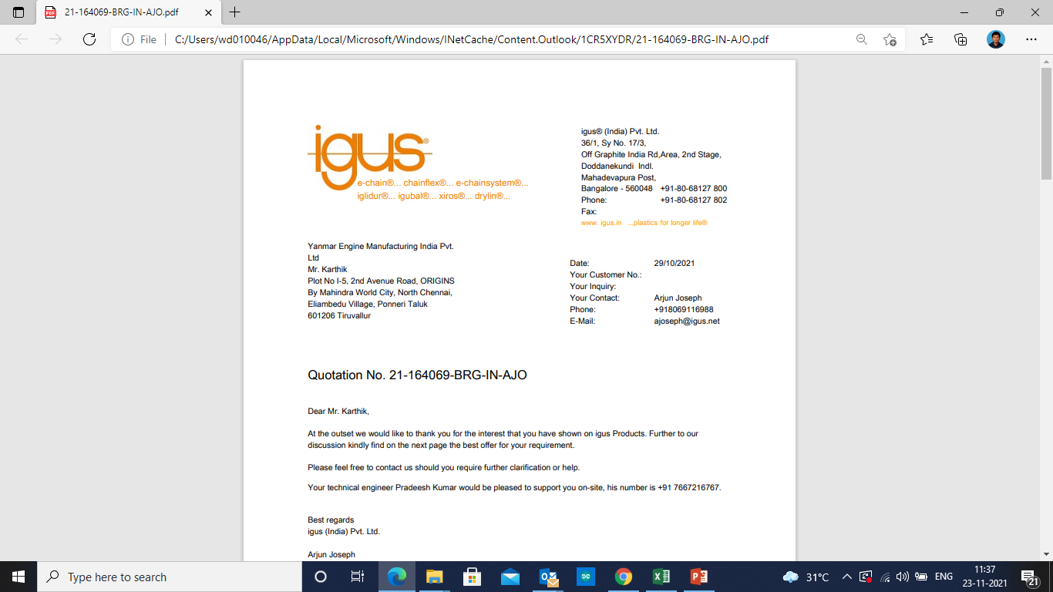
Quote received from IGUS:

