Slide 1
Certification on Emerging Technologies

Slide 2
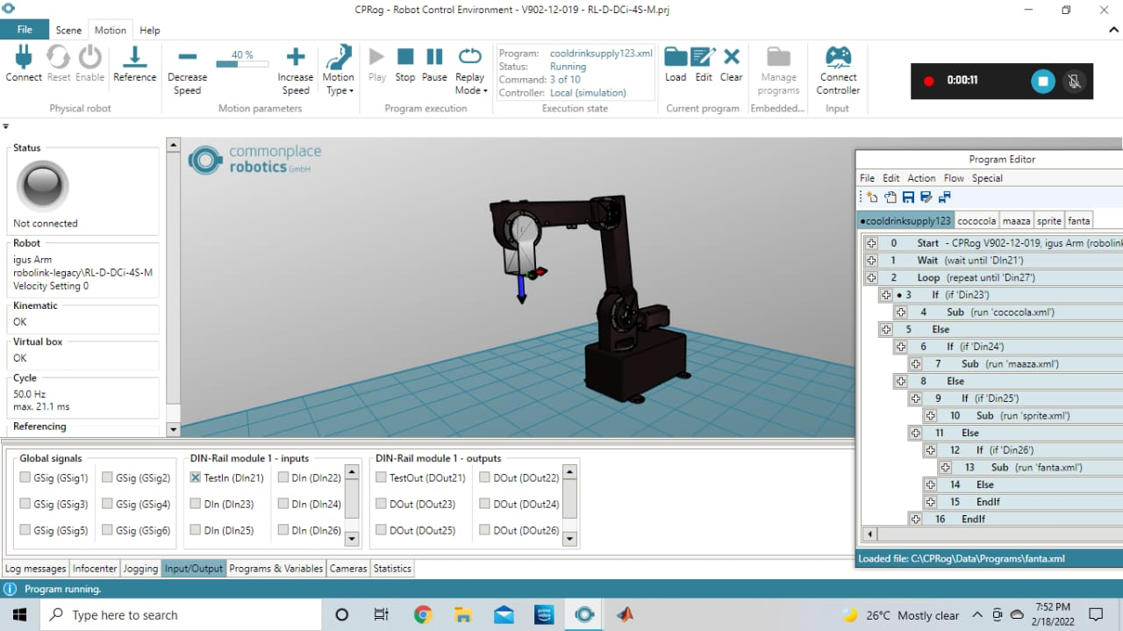

Slide 3
