Slide 1
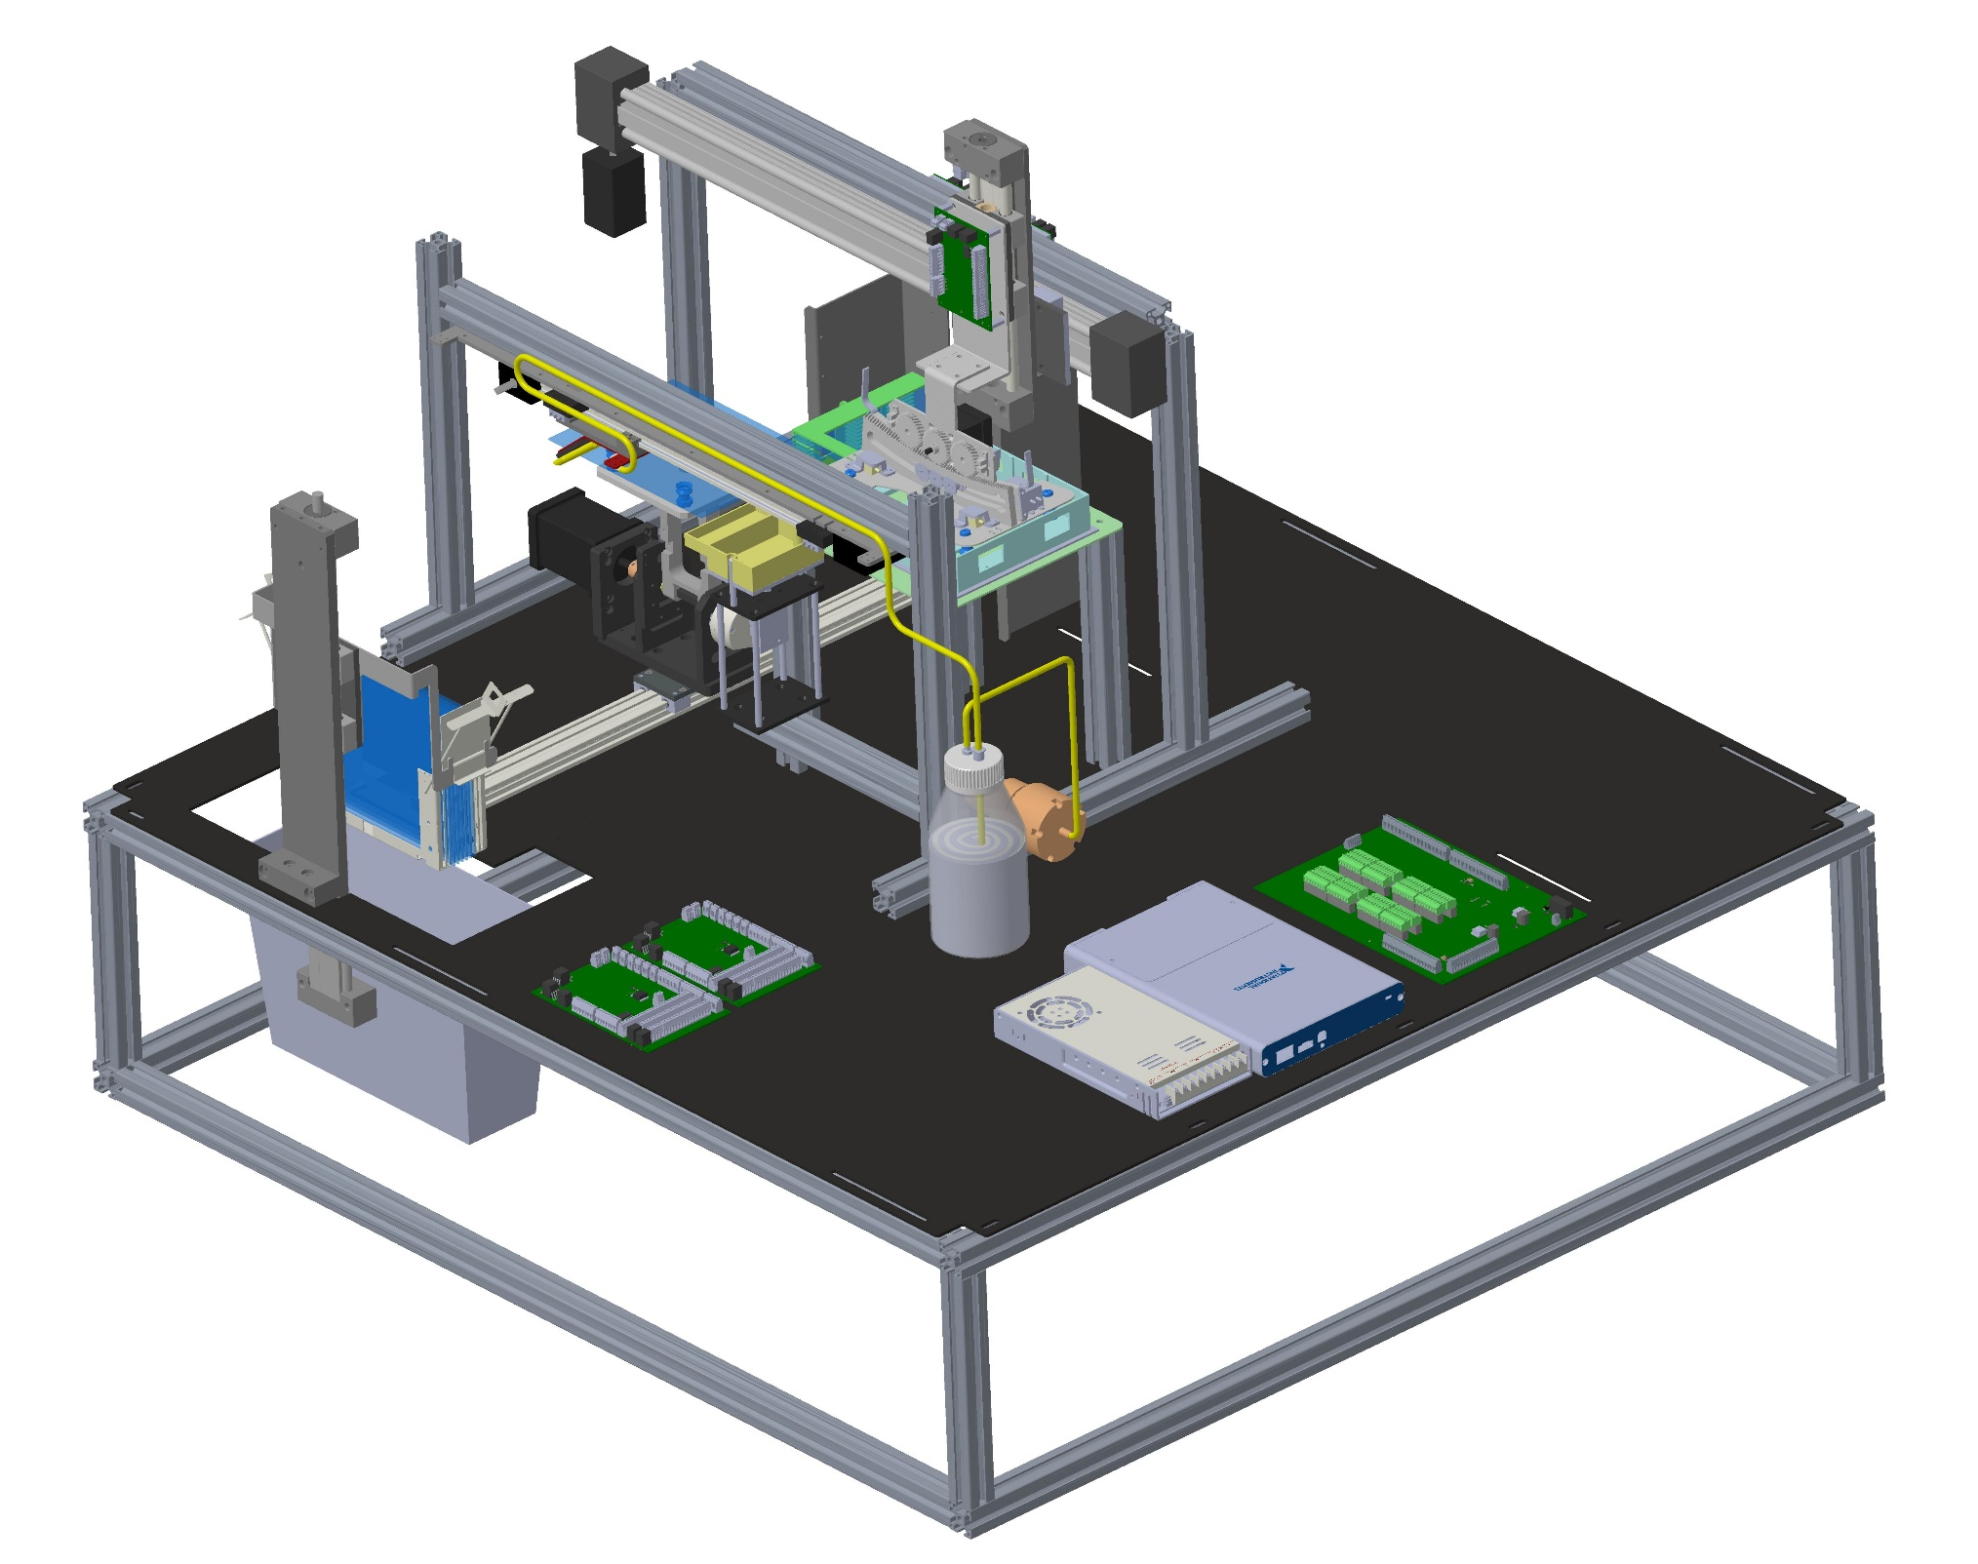
AUTOMATED LARGE FORMAT COVERSLIPPER

Slide 2
BACKGROUND OF THE INVENTION
As known in the art, cover slipping is the process by which protective glass sheets are pasted over glass slides with tissue specimens. The primary goal of this process is to protect the specimen from external environment and impacts, and to improve the visibility by straightening the tissue. In the current art, cover slipping is performed on slides that are smaller in size. For example, a generic microscope slide measures about 75 mm × 25 mm (3 inch by 1 inch) and is about 1 mm thick. A range of other sizes are available for various special purposes, such as 75 x 50 mm for geological use, 46 x 27 mm for petrographic studies, and 48 x 28 mm for thin sections. Generally, the currently available automated cover slippers can only handle smaller slide sizes, typically, 25 X 75 mm (1” X 3”) slides and are incompatible to process large format slides and cannot switch between different sizes of slides.

Slide 3
However, there is a requirement to provide an efficient way to automate cover slipping of large format histology slides, for example, (150 X 200mm) while retaining compatibility to medium and small slides also. Current commercial products can only process single or two sizes of slides. Being an electromechanical device and since the size of the slide is large, there is a need for a device needs to be controlled by a custom defined protocol logic to perform error free cover slipping of such large format slides. The device should be capable of handling transport of stacks of such large format slides and continuously performs the process. The automation should also result in error-free, uniform cover slipping by preventing air-pockets between the coverslip and the slides while ensuring minimal or no presence of air bubbles. There is also the need to take into consideration that to apply the slip permanently over the slide, an adhesive liquid called mounting medium is dispensed over the latter. Therefore, there is this need for an improved cover slipping and dispensing technique that ensures uniform distribution of mounting medium thus ensuring zero or minimal in-significant air gaps.

Slide 4
SUMMARY OF THE INVENTION
The cove slipper disclosed herein addresses the need for an improved cover slipping and dispensing technique that ensures uniform distribution of mounting medium thus ensuring zero or minimal in-significant air gaps. The cove slipper is designed to handle large format slides, for example, 150 mm X 200 mm, since the current practice of analysing slides is limited to small sizes, typically 25 X 75 mm thus incompatible to analyse larger tissues such as human or large animal brains. As the current slides processed are smaller in sizes, only small size coverslips matching those slides are internally transported and processed by currently available cover slippers in market. The cove slipper disclosed herein is capable of internally transporting and processing cover slips compatible to and dimensionally suiting the large format slides. Furthermore, the cove slipper has compatibility to process small, medium, and large format slides. The formats process small format slides only and cannot be programmed/modified/customized to suit other sizes. This cove slipper provides possibilities to customize the relevant critical components of the system to suit small, medium, and large format slides.

Slide 5
This cove slipper uses a unique pickup technique. The large format coverslip is of dimension 150 X 200mm with thickness of 0.17mm, which is large and is made up of thin glass, brittle and difficult to handle manually for cover slipping. Several such slides are stacked in a cover slip magazine amongst which the topmost coverslip shall be picked by a picker assembly. If not handled properly, the picking up of the cover slip could result in multiple slips picked up together or breakage of the coverslips. To facilitate a smooth and firm picking of single coverslip from the magazine, a custom-made centre pivoted picker plate is designed with multiple double bellow vacuum cups positioned at strategic places. The double bellow vacuum cups are used specifically to have a cushion effect during picking up of the coverslip with minimal impact that ensures the coverslip is intact while picking.
The vacuum cups are provided with an optimal suction pressure to create a smooth picking action, hence preventing any breakage of coverslip. The picker plate is pivoted to a mechanism with axis motors which, in turn, provides a rotational motion for picking. With this rotational motion, the coverslip is picked from one end (with front end vacuum cups), followed by a rolling motion, the tail end of coverslip also is picked. Due to this technique of picking, it is empirically and experimentally verified that only an individual topmost coverslip is picked up safely.

Slide 6
Overall Functional Schematic

Slide 7
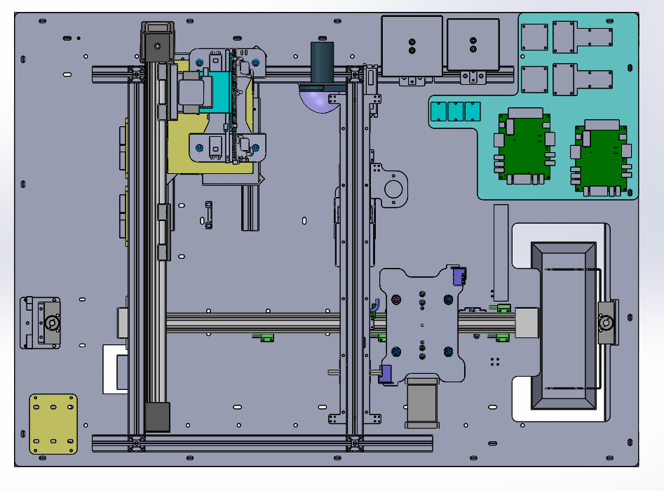
Screenshot of 3D design model

Slide 8
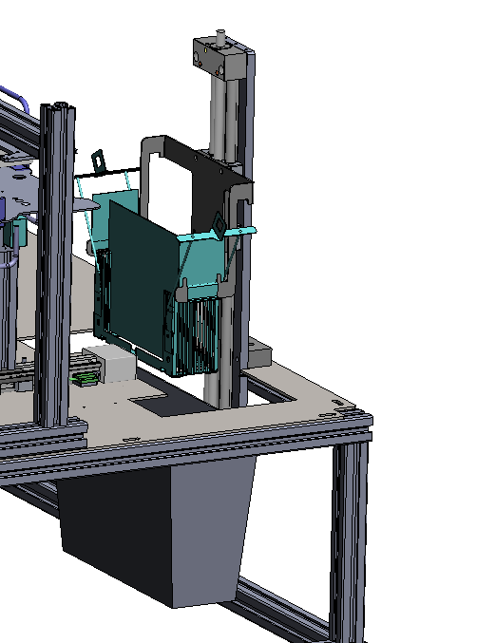
MODULE DESCRIPTION
INPUT ZONE:
This zone has provisions for holding a Slide Tray . The Slide Tray contains a stack of stained slides inserted into evenly spaced grooves. The Slide Tray is vertically moved up and down to position the slide currently waiting to be picked up. The slide is picked up by a suction cup arrangement on the Slide Pick-Up Platform. Slides will be picked up from bottom to top
Challenges:
The vertical motion should be very smooth and slow as it is handling a stack of brittle glass plates ( slides)
Solution:
Drylin drive axis with E-control system (SLW 1040, 2mm pitch lead screw for 350mm stroke) has been chosen for this function
SLW 1040
Slide tray
Input tray

Slide 9
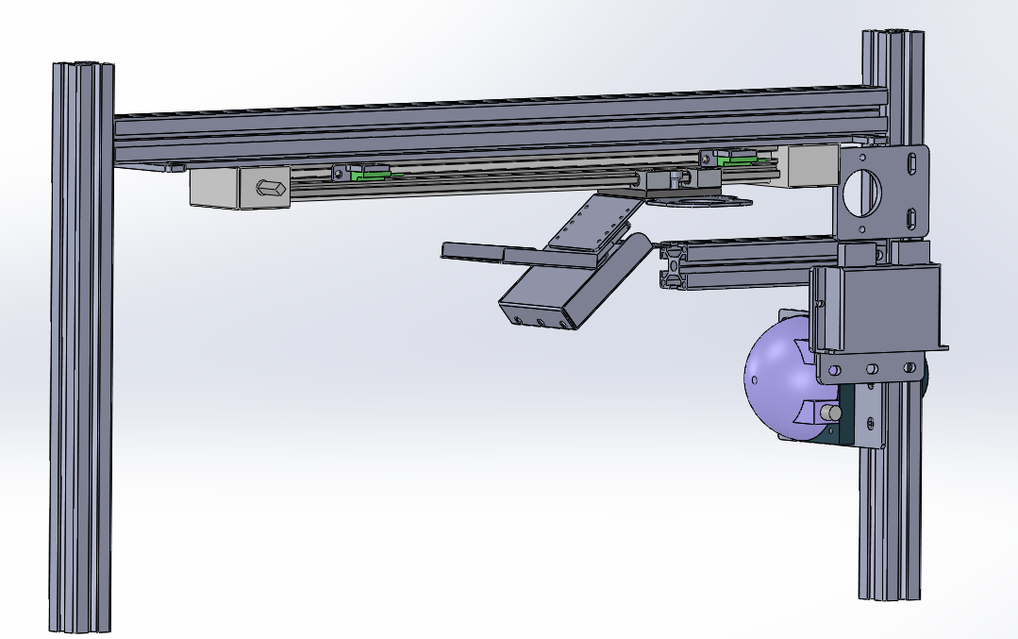
MODULE DESCRIPTION
DISPENSATION ZONE:
once the slide pick-up platform reaches this zone, mounting medium is dispensed through wedge shaped nozzle which performs a uniform mounting medium dispense from container. about the dispenser nozzle park zone, after dispensing, the dispenser nozzle is rest to home position
Challenges:
The horizontal motion of dispense nozzle should be achieved with 2 different speed like too fast( to move from home to end of slide) as well too slow while dispensing ( cover 140mm in 10 secs) .
Should be less weight module since the dispense nozzle is very thin
Solution:
Drylin drive axis with E-control system (ZLW 0630_300mm stroke) has been chosen for this function
ZLW 0630
Dispense nozzle

Slide 10
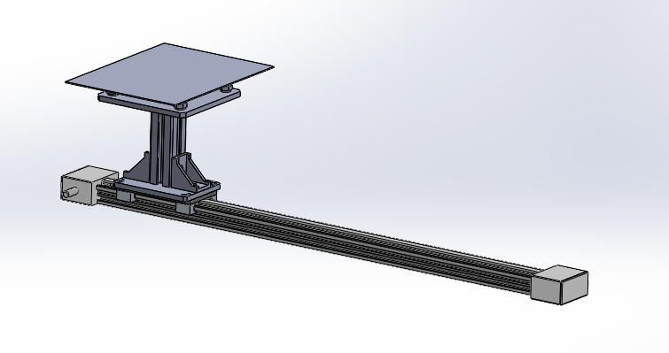
MODULE DESCRIPTION
SLIDE TRANSPORT ZONE:
once the slide pick-up platform reaches this zone, mounting medium is dispensed through wedge shaped nozzle which performs a uniform mounting medium dispense from container. about the dispenser nozzle park zone, after dispensing, the dispenser nozzle is rest to home position
Challenges:
The motion of slide transport should be smooth enough in high speed, as the slide has to travel to all 4 zone to perform a complete cycle.
Also the glass slides which is picked up should not slip or displace from its co-ordinates due to high speed and braking conditions.
Solution:
Drylin drive axis with E-control system (ZLW 0630_600mm stroke) has been chosen for this function, which is controlled to drive at different speed without any deformation or displacement of slide co- ordinates

Slide 11
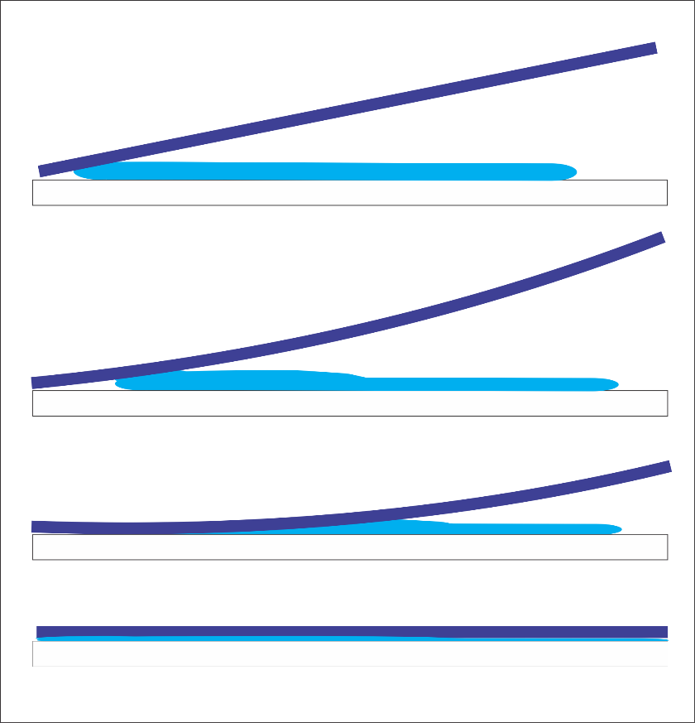
MODULE DESCRIPTION
COVERLSIP PICK & PLACE ( COVERSLIPPING ZONE):
Here the coverslip ( 150 X 200 X 0.17mm thick) 170 microns glass sheet is to picked and transported to coverslipping zone and place the coverslip on top of slide glass ( 150 X 200 X 1.2mm thk)
Challenges:
According to inhouse study, A Rolling Motion Mechanism is to be implemented to facilitate and perform automation of the below mentioned procedure of cover slipping.
the coverslip(170 microns thin brittle glass sheet) is picked up gently from the cover slip magazine.
Position cover-slip directly above the slide exactly matching the slide’s position.
Bring the start end of cover-slip towards slide and place on slide
Ensure the starting contact area between cover-slip and slide is less than empirically determined level to prevent air pockets.
Roll on the cover-slipper mechanism towards end of slide in such a way that this action spreads the mounting medium all over the slide area till end of slide, uniformly.
Release the cover-slip.
1
2
3
4
Coverslipping steps

Slide 12
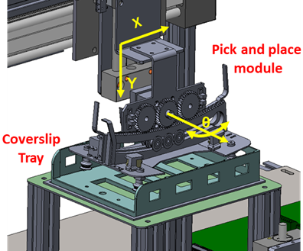
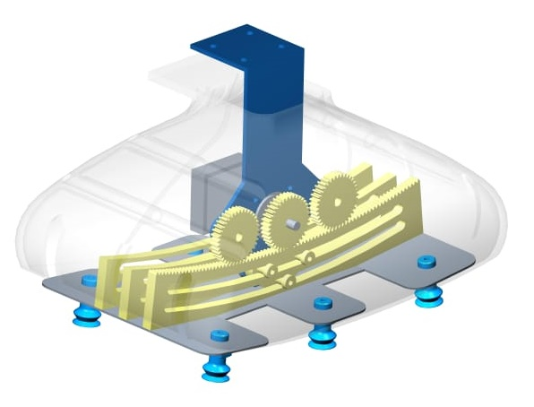
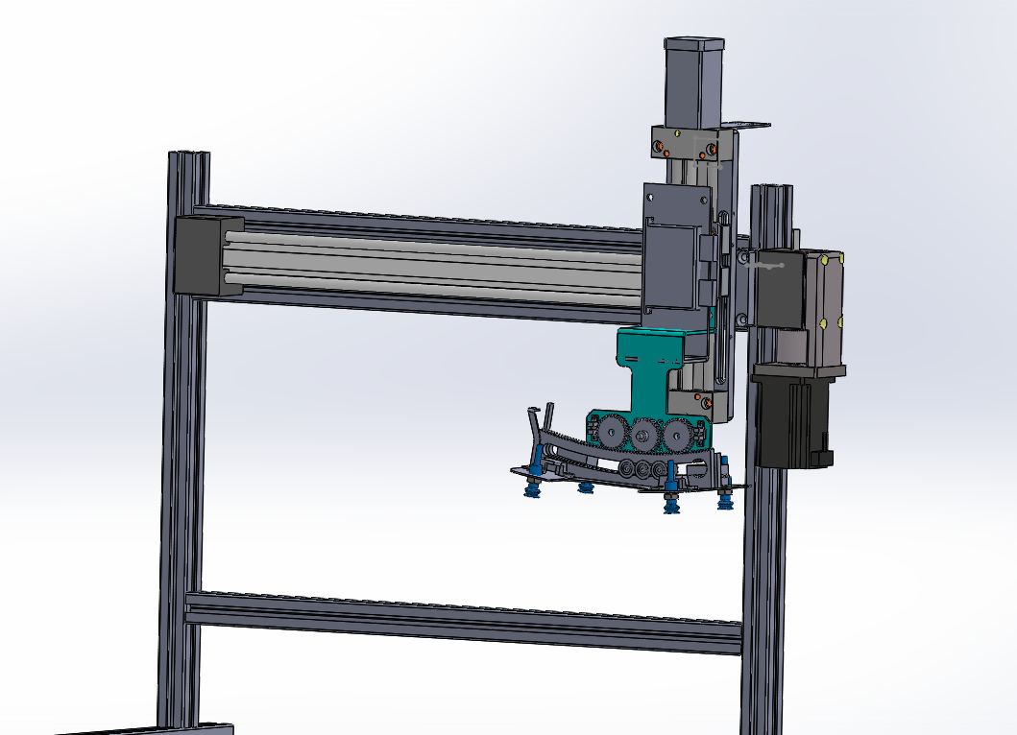
Solution:
The rolling motion mechanism deploys a three-axis motion mechanism with the functions, namely,
1. Transportation of cover slip – X-axis Motion
2. Picking and Placement – Y- axis motion
3. Rolling motion mechanism to facilitate
Cover slipping – Z-axis motion.
X axis - Drylin drive axis with E-control system (ZLW 1040_600mm stroke)
Y axis - Drylin drive axis with E-control system (SLW 1040_150mm stroke)
Z axis – a custom design( curved rack and pinion mechanism) is developed
SLW 1040
ZLW 1040
Based on software analysis of the motion pattern required for the above cover slipping technique, the locus of motion was deduced, and an algorithm is used for the same. This algorithm controls and defines the movements of each individual axis and synchronized operation of all the axes.
3 axis system

Slide 13
MODULE DESCRIPTION
OUTPUT ZONE:
once the slide pick-up platform reaches this zone, mounting medium is dispensed through wedge shaped nozzle which performs a uniform mounting medium dispense from container. about the dispenser nozzle park zone, after dispensing, the dispenser nozzle is rest to home position
Challenges:
The horizontal motion of dispense nozzle should be achieved with 2 different speed like too fast( to move from home to end of slide) as well too slow while dispensing ( cover 140mm in 10 secs) .
Should be less weight module since the dispense nozzle is very thin
Solution:
Drylin drive axis with E-control system (ZLW 0630_300mm stroke) has been chosen for this function
ZLW 0630
Dispense nozzle

Slide 14
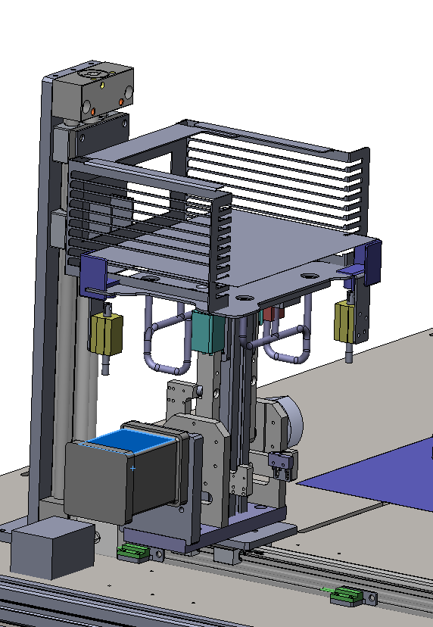
MODULE DESCRIPTION
OUTPUT ZONE:
This zone has provisions for holding a Slides after coverslipping operation.
The slide Tray contains a stack of stained slides inserted into evenly spaced grooves. The Slide Tray is vertically moved up and down to position the slide currently waiting to be loaded up. The slide is loaded by a slide transport moduel. Slides will be placed from top to bottom
Challenges:
The vertical motion should be very smooth and slow as it is handling a stack of brittle glass plates ( slides)
Solution:
Drylin drive axis with E-control system (SLW 1040, 2mm pitch lead screw for 250mm stroke) has been chosen for this function
SLW 1040
Output tray
Slide tray
Slide transport( ZLW 0630)

